Slide 1
Math In Python

Slide 2
Introduction
Computers perform calculations very much like a scientific calculator
Almost all programming languages (including Python) support mathematical operations as part of the source code
Python will interpret mathematical statements and compute a result

Slide 3
Basic Arithmetic
Mathematical Operation | Symbol in Python
Addition | +
Subtraction | -
Multiplication | *
Division (float) | /
Division (integer) | //
Modulus (Remainder after Integer Division) | %
Exponents | **
Brackets | ()

Slide 4
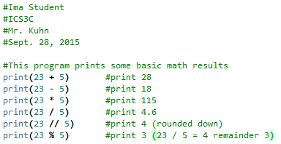

Arithmetic Examples

Slide 5
Advanced Functions
Python has a math library that must be imported before advanced functions can be used.
If you require advanced functions, add the following line at the beginning of your program:
  import math

Slide 6
Advanced Functions
Mathematical Operation | Function in Python
Square root | math.sqrt(number)
Pi (approx. 3.14159) | math.pi
Round a result to a certain # of decimal places | round(number, # of decimals)
Round down (nearest whole) | math.floor(number)
Round up (nearest whole) | math.ceil(number)
Maximum of 2 or more numbers | max(number1, number2, …)
Minimum of 2 or more numbers | min(number1, number2, …)
absolute value | abs(number)
Note: The math library contains many functions including trigonometry, logarithms, and e^x. Visit https://docs.python.org/3/library/math.html for a complete list of functions

Slide 7
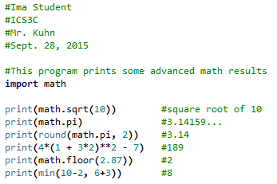
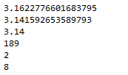
Advanced Function Examples

Slide 8
Notes About Math
Python follows order of operations: (BEDMAS)‏
Python has two divisions
  Use / for most divisions. The result will always be a float (decimal) value
  Use // whenever you want the result to be an integer. Python will always round down
The modulus (%) operator is surprisingly useful!
Don’t forget to consult the Python math library for more functions.

